Slide 1
Guidelines – Pre-pitching
Please provide confirmation of your participation three (3) working days before the date stipulated in the invitation email.
Prepare your Pitch Deck using this sample as a guide.
You may also prepare the Pitch Deck in Bahasa Malaysia using the sample Pitch Deck in Section 2 from page 23 to 44.
You can add or delete any of the slides given for your actual presentation, however, it is highly recommended that you include all the information required in your Pitch Deck. For example, you might want to start with an ‘Elevator Pitch’ to highlight the product, technology etc.
You may re-arrange the slides to suit your style of presentation.
Please do not prepare your Pitch Deck in a ‘Question and Answer’ format.
Please incorporate your Pitch Deck PowerPoint slides when you submit the Pitching Registration Form.
Acceptance to any revisions to the Pitch Deck after the submission of the Pitching Registration Form will be subjected to the organiser’s discretion.

Slide 2
Guidelines – Pitch Day
Please be at the pitching venue at least 30 minutes before your allocated slot.
No-shows and last minute cancellations without a suitable reason will be subjected to a cooling-off period of two (2) weeks before being allowed to reschedule the pitching session.
You are reminded to adhere strictly to the time limits given. Each company will be given 15 mins to present your slides and another 15 mins will be allocated for Q&A after the presentation.
A laptop and laser pointer will be provided for your use. Copy of the Pitch Deck will be on the laptop for your presentation.
To ensure that the pitching session proceeds smoothly, any requests to use your own laptop, USB pen drive etc. will not be entertained.
You are welcome to bring prototypes or samples for the panelists to view. Please note that MTDC has a strict No Gift Policy, thus any samples, gifts etc will not be accepted.
The pitching can be done in English or Bahasa Malaysia or mix of both.

Slide 3
Guidelines – Pitch Day
(Additional For Online Pitching)
We will conduct the Online Pitching Session via ZOOM.
The URL to join the ZOOM meeting room will be e-mail to you before the pitching session.
Please ensure you have sufficient bandwidth to ensure good connection and smooth session.
Please be ready to connect to ZOOM 10 minutes before the session.
You area advised to familiarise yourself in using ZOOM platform before the pitching session.

Slide 4
Guidelines – Post-pitching
You will receive the outcome of your pitching session not more than seven (7) working days after your session.
You will be informed of your eligibility to apply for funding/other services from MTDC and also be informed of the next steps should you be eligible for funding/services.

Slide 5
Sample Presentation
Company Name & Logo
Contact information
One Line Description of what your company does
Date
Presenters

Slide 6
The Company
Name of company
Date of incorporation
Company website
Information on shareholding structure
  Please also indicate if there is any shares option pool for the team member
Directors
Auditors
Date of last audited accounts
Other relevant information

Slide 7
The Pain/Problem
What is the customer’s pain/problem your product/services is addressing.
You are encouraged to provide proof of market data or research to support the problem statement

Slide 8
Current Solution (Competitors)
What are the current competing solutions used to address that pain/problem?
What are these competitors’:
  Strengths
  Weaknesses

Slide 9
Your Solution
How will you address the pain/problem?
How different is your solution compared to the currently available competing solutions?
You are encouraged to provide the photos of your product(s).
How much better is your solution? Please support with market study or research results.
What are your solutions:
  Strengths
  Weaknesses

Slide 10
Technology
Explain the technology, special process, solution or mechanism – in simple terms.
Please provide the source of technology
  In-house research
  Collaboration with universities, research institutes etc
  Acquisition (foreign or local)
  Others (please state)
Why is it unique, differentiable, and sustainable?
  How is it protected?
  Current status of IP
Current status of the technology development and demo results.
Please make it simple and understandable under this section.

Slide 11
Market Size Opportunity
What are the different segments in the market? – Total Addressable Market (TAM), Specific/Serviceable Addressable Market (SAM), Specific/Serviceable Obtainable Market (SOM), etc..
Please also state your assumptions, if any.
How big is the opportunity ?
What is its rate of growth?
Please specify the source of market analysis.

Slide 12
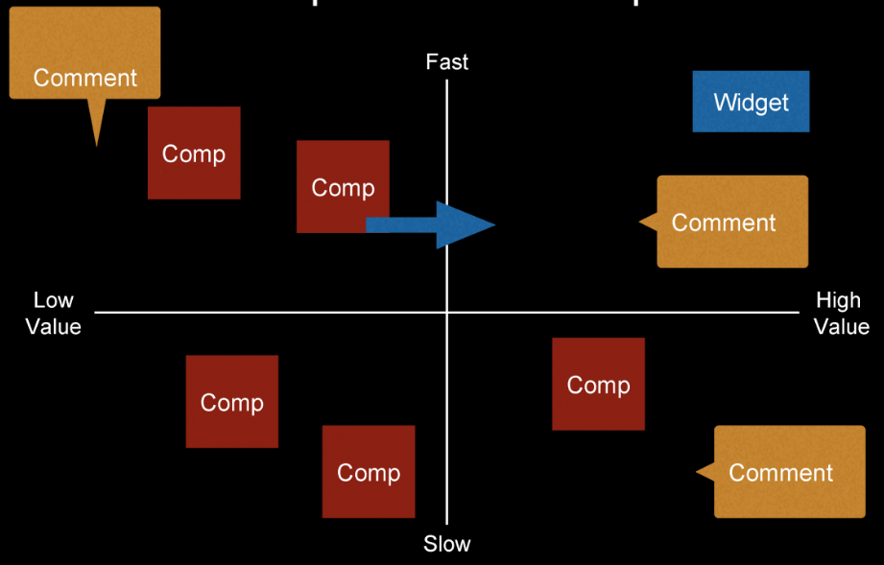
Competitive Landscape
* Optional if you want to show where are you compared to competitors

Slide 13
Go To Market Strategy
You may use the matrix below to show your roadmap from entering to market to scaling up focusing on the following items:-
  Your initial target customers
  Focused region
  Getting the initial traction
Please also state your assumptions, if any
What is the traction achieved so far?
How big is the opportunity ?
What is the rate of growth?
Please specify the source of market analysis
 | Traction | Build | Scale
Target Clients and Offering
Target Region
Sales and Channels

Slide 14
Revenue Model
Explain how you derive your revenue.
Sample of revenue model can be:-
  Retail sales
  Contract manufacturer / OEM
  Subscription based
  Licensing
  Transaction fees
What is the pricing per unit?
What is the gross profit per unit?
Please explain your delivery strategy if you have not explained in earlier slides.

Slide 15
Financial Forecast
Please provide a 3-year profit forecast
  The forecast should provide the following major items:-
    Revenue
    Gross profit
    Net profit
    EBITDA
  Please state the major assumptions used in arriving at the forecast figure
  The forecast should includes the following:-
    The revenue should tally with the revenue model provided in the earlier slides
    Assumption that the funding required is received
Please also show your last 2 years income statement / profit and loss accounts (if available).
When was the latest audited financial statements? What was the financial result?

Slide 16
Milestones to Date
Include major value creations that the company has accomplished, such as major contract signed, testing & certifications done, etc.
Please include the grant name, agency providing the grant, date and amount of grant received, if any.

Slide 17
Funding Sought
How is the company currently being funded.
How much funding the company planning to raise & how will be funds be utilised.
How long will the fund last? Will the company require further funding before it reach cash break even?
Breakdown of the funds:
  External (bank loans, Venture capital, grants, etc)
  Internal (shareholders)

Slide 18
Deliverables
What will the company achieve with the new funds – e.g sales increase, new customers, increase in production capacity, etc.

Slide 19
Team
Founders and owners
Other team members
Roles & responsibilities – who does what?
Why this team:
  Why are they the best in what they do?
  Does the team has the skills & experiences required?
What are the skill gaps? Skills that are lacking in the current team that need to be addressed & how they will be filled in the future.
You may use the template in the next slide as a guidance

Slide 20
Founders
Photo
CEO
Mus
Role : Business Development
History : Head of Bus Dev Boustead Engineering
Stats: Age: 32, Experience : 8 years
Education: UiTM
Photo
CTO
Jeff
Role : Product Development, R&D
History : CTO of Sapura Engineering
Stats: Age: 35, Experience : 12 years
Education: UPM
Key Team Player
Photo
Name : Lee
Role : Lead dev
Experience : 10 yrs at FGV
Photo
Name : Mohsin
Role : Lead dev
Experience : 12 yrs at ABC Int
Advisors
Photo
Name : Muhammad
Role : Financial Advisor
Experience : 10 yrs as start-up advisor
Photo
Name : Prof Jane
Role : Tech advisor
Experience : Principal Researcher at UPM

Slide 21
Q&A

